Slide 1


Slide 2

An introduction to MongoDB
Sathish Ravikumar

Slide 3
SQL vs NoSQL
Agenda
Introduction of MongoDB
MongoDB Features
Replication/ High Availability
Sharding/ Scaling

Slide 4
SQL vs NoSQL
NoSQL (often interpreted as Not only SQL) database
It provides a mechanism for storage and retrieval of data that is modeled in means other than the tabular relations used in relational databases.
SQL | NoSQL
Relational Database Management System (RDBMS) | Non-relational or distributed database system.
These databases have fixed or static or predefined schema | They have dynamic schema
These databases are best suited for complex queries | These databases are not so good for complex queries
Vertically Scalable | Horizontally scalable
Follows ACID property | Follows BASE property

Slide 5
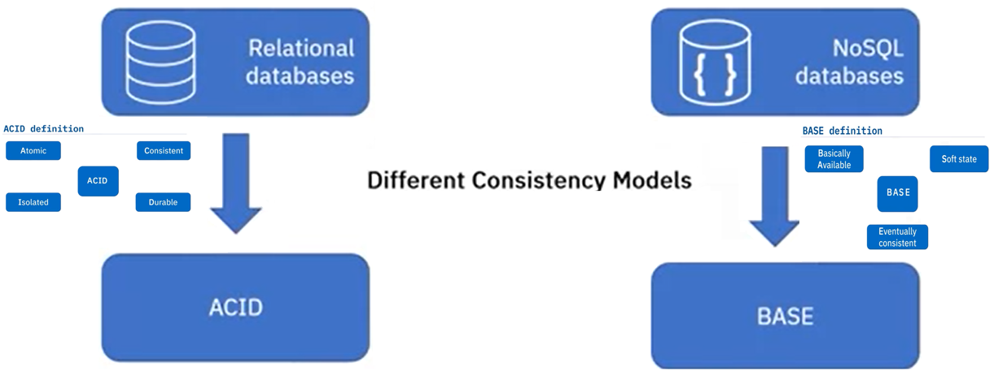
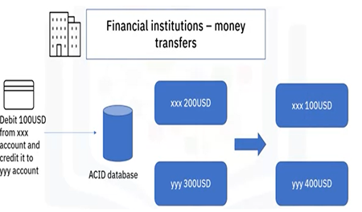
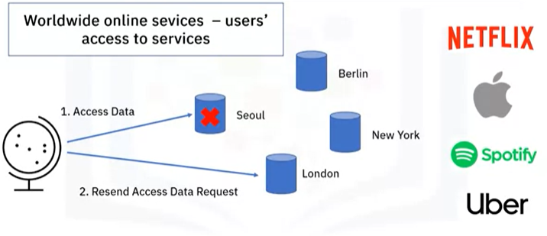
SQL vs NoSQL

Slide 6
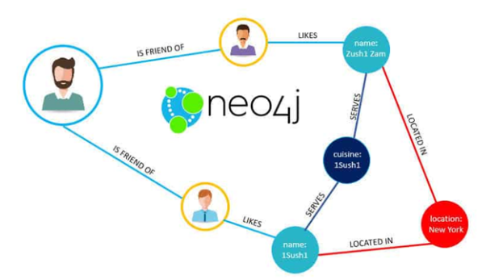


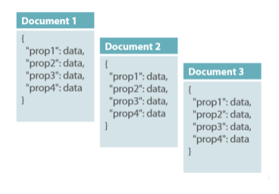


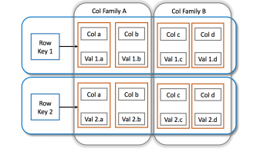
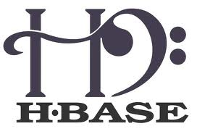

NoSQL Types
Graph database
Document-oriented
Column family

Slide 7
What is MongoDB?
MongoDB is an open source, document-oriented database designed with both scalability and developer agility in mind.
Instead of storing your data in tables and rows as you would with a relational database, in MongoDB you store JSON-like documents with dynamic schemas(schema-free, schema less).
{
"_id" : ObjectId("5114e0bd42…"),
“FirstName" : "John",
“LastName" : "Doe",
“Age" : 39,
“Interests" : [ "Reading", "Mountain Biking ]
“Favorites": {
"color": "Blue",
"sport": "Soccer“
}
}

Slide 8
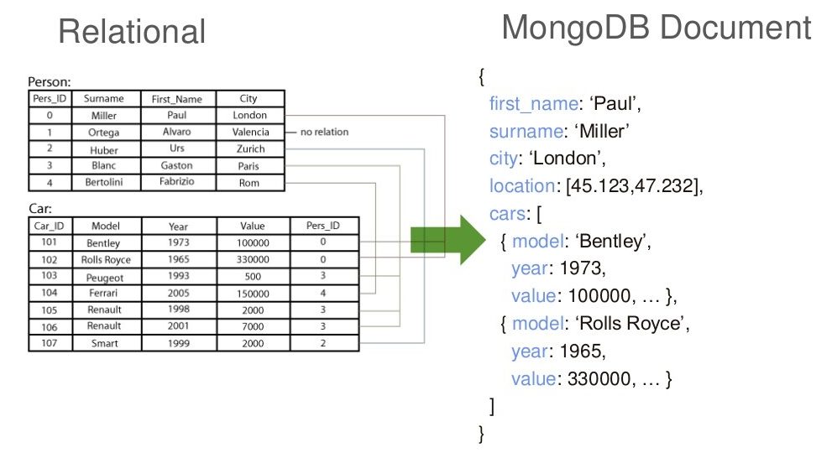
MongoDB is Easy to Use

Slide 9
Scheme Free
RDBMS vs MongoDB
MongoDB does not need any pre-defined data schema
Every document could have different data!
RDBMS |  | MongoDB
Database |  | Database
Table |  | Collection
Row |  | Document (JSON, BSON)
Column |  | Field
Index |  | Index
Join |  | Embedded Document
Partition |  | Shard
{name: “will”,
eyes: “blue”,
birthplace: “NY”,
aliases: [“bill”, “ben”],
loc: [32.7, 63.4],
boss: ”ben”}
{name: “jeff”,
eyes: “blue”,
loc: [40.7, 73.4],
boss: “ben”}
{name: “brendan”,
boss: “will”}
{name: “matt”,
weight:60,
height: 72,
loc: [44.6, 71.3]}
{name: “ben”,
age:25}

Slide 10
Features Of MongoDB
Document-Oriented storege
Full Index Support
Replication & High Availability
Auto-Sharding
Aggregation
MongoDB Atlas
Various APIs
  JavaScript, Python, Ruby, Perl, Java, Java, Scala, C#, C++, Haskell, Erlang
Community

Slide 11
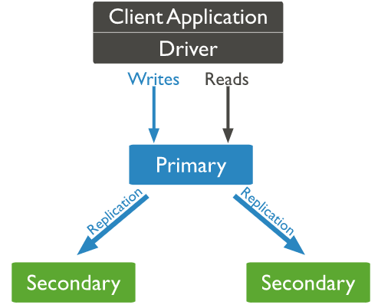
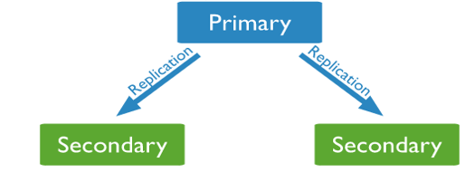
Replication
Replication provides redundancy and increases data availability.
With multiple copies of data on different database servers, replication provides a level of fault tolerance against the loss of a single database server.
Copy of database
Copy of database

Slide 12
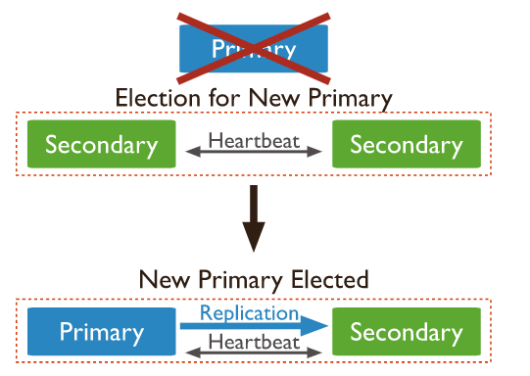
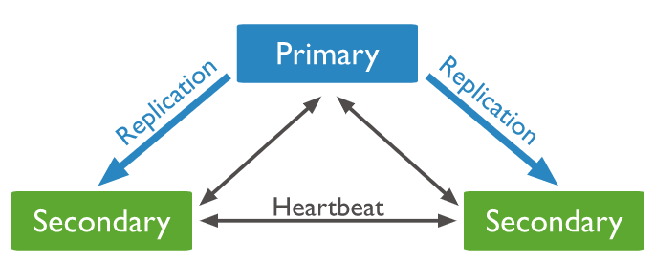
Replication

Slide 13
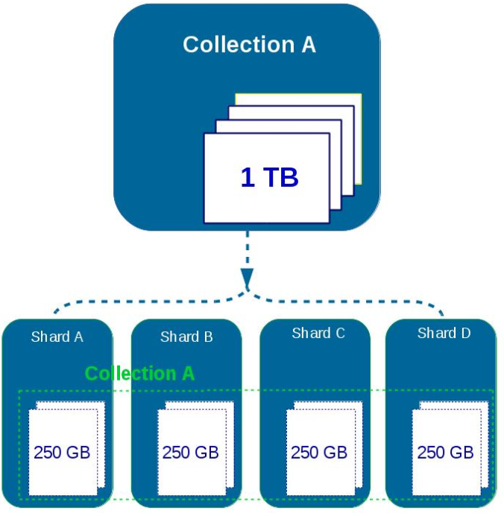
Sharding
Sharding is a method for distributing data across multiple machines.
MongoDB uses sharding to support deployments with very large data sets and high throughput operations.

Slide 14
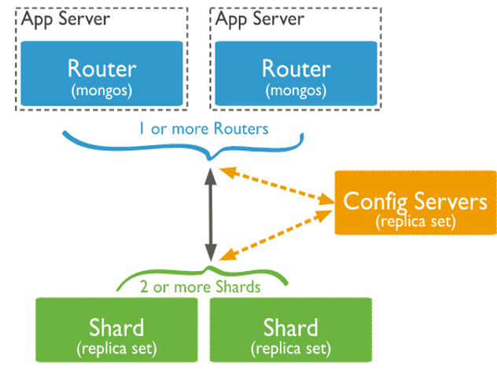
Sharding Architecture
Shard is a Mongo instance to handle a subset of original data.
Mongos is a query router to shards.
Config Server is a Mongo instance which stores metadata information and configuration details of cluster.

Slide 15
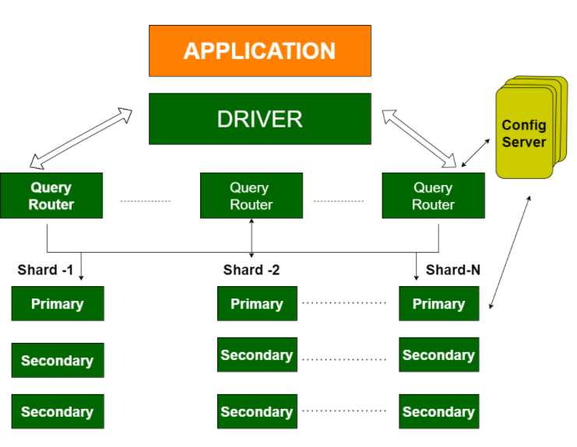
Sharding/Replication
Replication Split data sets across multiple data nodes for high availability.
Sharding scale up/down horizontally when it is required for high throughput

Slide 16
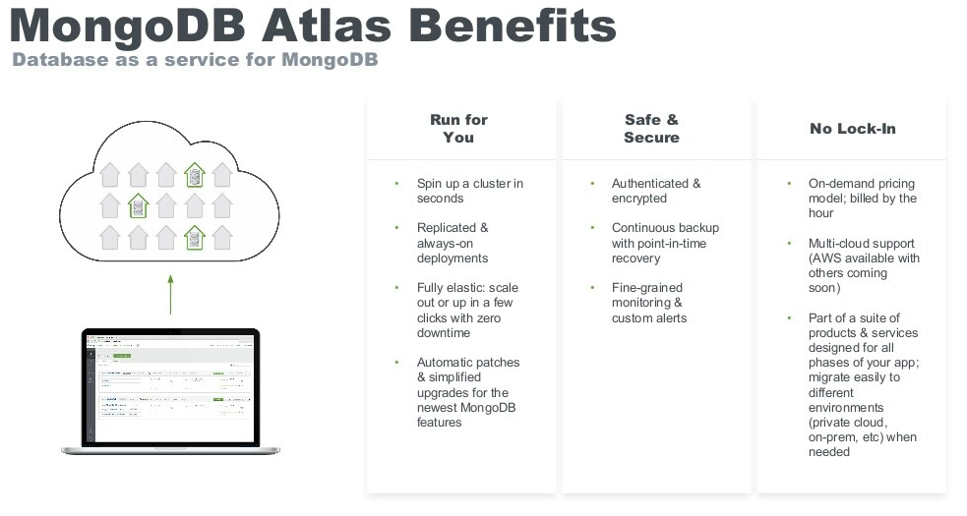

Slide 17


